Slide 1
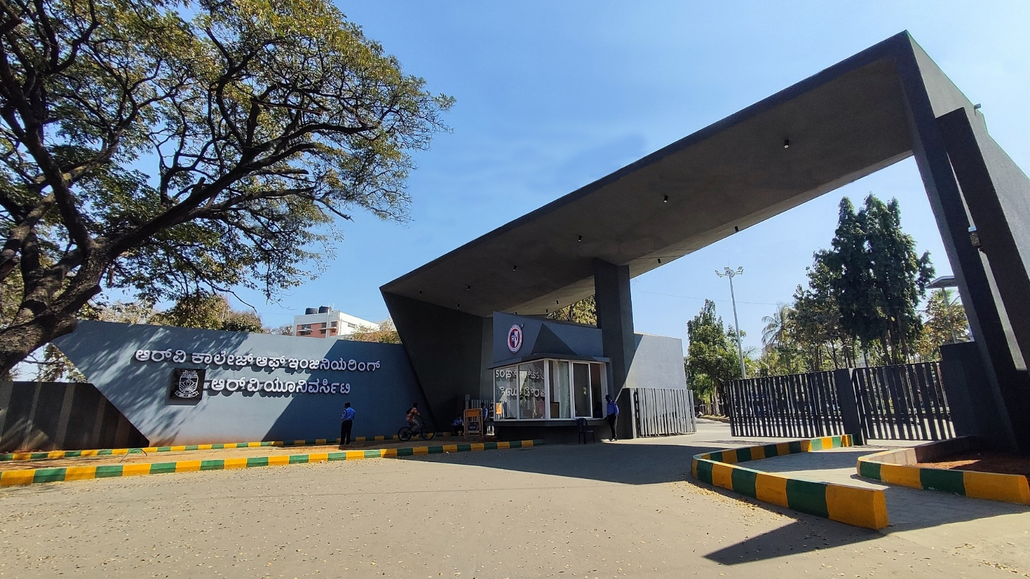
Colorimetric Surveillance of gas leaks in Chemical Industries Using Bioindicator Monitoring System
Manufacturing processes / team number: 32

Slide 2





DEEP GAZE
AARUSH GARG
GAURAV KUMAR
Prof Manasa M
Assistant Professor
AIML
KASVI GUPTA
MAHAK MITTAL

Slide 3
EL Phase-II
Presentation Outline
Introduction
Project Overview
Comments during EL Phase-I and action taken.
Tools and Techniques Used
Project Progress
Analysis of Partial Results
Deliverables and Outcomes
Future work (Remaining tasks)
Conclusion

Slide 4
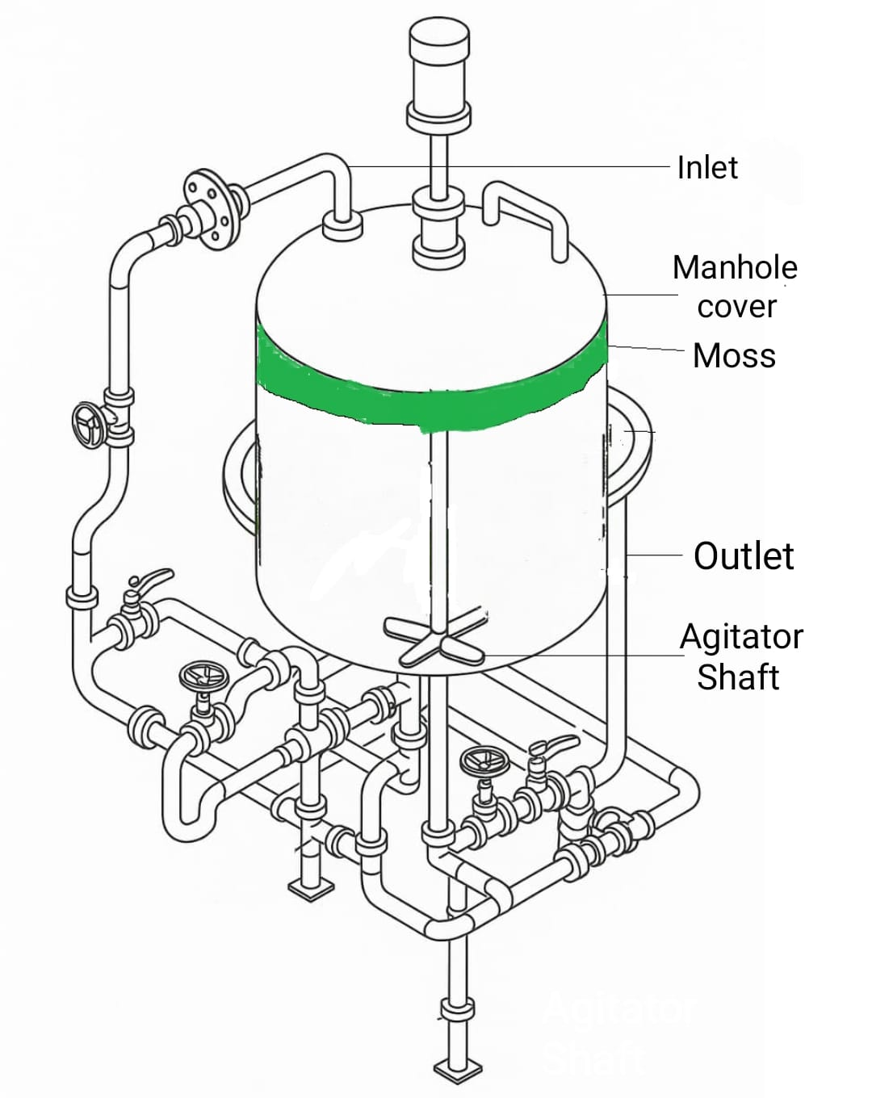
Introduction
Overview of the topic: Gas leaks in chemical plants—especially slow leaks near manhole gaskets in Chemical Mixing Reactors (CMRs)—often go unnoticed by conventional sensors placed far from the source. Our project uses bioindicators(like moss) and computer vision to detect these leaks by analyzing visible changes, like color shifts in the indicator material.
Importance of the topic: According to a global study by the Center for Chemical Process Safety, over 60% of chemical plant incidents are linked to undetected leaks of hazardous substances. In many industrial environments, chemicals like sulphuric acid (H₂SO₄), ammonia (NH₃), hydrochloric acid (HCl), and methanol (CH₃OH) are routinely used and even a small, slow leak from a gasket or pipeline can go unnoticed, eventually posing serious health risks and regulatory concerns. Traditional detection methods such as manual tools like sulphur sticks or costly electronic sensors that are either hazardous, require frequent calibration, or are impractical for widespread continuous monitoring. A bioindicator-based system, such as the use of moss to detect gas exposure through visible color changes, offers a novel, low-cost, real-time, and environmentally sustainable alternative for early leak detection in confined and sensitive areas.

Slide 5
Problem Definition
Clear statement of the problem: Current gas leak detection systems in chemical mixing reactors fail to reliably detect slow and low-concentration gas leaks,particularly those occurring at the base near manhole gaskets.
Context of the Problem: Gases like SO₂, H₂S, and CO are commonly present in chemical industries. These gases can leak through degraded gaskets at the manhole cover, a common weak point in CMRs. However, traditional sensors are typically mounted at elevated positions or centralized locations, making them ineffective at detecting gas accumulation near the leak site. Furthermore, these sensors are often expensive, require regular maintenance and calibration, and are not suited for continuous, localized monitoring
Significance of Addressing the Problem: Slow gas leaks, if left undetected, can lead to long-term worker exposure, fire or explosion risks, and environmental regulation breaches. Current systems lack affordable, continuous monitoring near vulnerable points like manhole gaskets. Addressing this gap can enhance on-site safety, ensure compliance, and reduce the cost and complexity of gas leak detection.

Slide 6
Objectives
Main Objective:•
Development of a Low-Cost, Passive Biosensing System Using Moss:
To Employ moss species as bioindicators to detect hazardous gas leaks— specifically hydrogen sulphide (H₂S), sulphur dioxide (SO₂), and carbon monoxide (CO)—by analysing physiological stress responses such as chlorophyll degradation, anthocyanin accumulation, and pigment discoloration under gas exposure, enabling a sustainable and maintenance free detection mechanism.
Integration of Computer Vision for Quantitative Colorimetric Analysis: To Design and implement a computer vision pipeline utilizing image preprocessing, colour space transformation, and machine learning algorithms to extract and interpret spectral changes in moss pigmentation, facilitating real-time, non-invasive detection of specific gas-induced stress signatures with high spatial resolution.

Slide 7
To ensure optimal performance of the bioindicator: by using cork as a mounting base for thermal insulation and moisture retention, along with integrated drip irrigation and humidity control for sustained responsiveness in industrial environments.Hydrogels will be embedded beneath the cork layer to provide moisture reservoirs thus buffering sudden temperature spikes
Specific Objectives:
Implementation of an Intelligent Threshold-Based Alerting System: Develop a multi-tier alert mechanism that activates audio-visual alarms and sends real-time notifications to on-site safety personnel when pigment degradation in moss exceeds calibrated stress thresholds—correlating with low to moderate gas concentrations

Slide 8
Project Overview
Problem statement:
Slow and low-concentration gas leaks near manhole gaskets in Chemical Mixing Reactors (CMRs) often go undetected due to limitations of conventional sensors—high cost, poor placement, and frequent maintenance needs.
Primary objectives of the project and its relevance to industry:
Use moss as a bioindicator to detect toxic gases via visible colour changes.
Apply computer vision (OpenCV, HSV) for real-time, non-invasive monitoring.
Integrate with IoT sensors (pressure, humidity, sound) for robust detection.
Expected impact or contribution of the project:
Offers a low-cost, eco-friendly, and real-time solution for industrial gas leak detection—enhancing safety, ensuring regulatory compliance, and enabling future scalability and research.

Slide 9
Literature Review
Research Paper | Authors | Year | Key findings
Perspective of Monitoring Heavy Metals by Moss Visible Chlorophyll Fluorescence Parameters | Yang-Er Chen¹, Nan Wu¹, Zhong-Wei Zhang², Ming Yuan¹ and Shu Yuan² | 2019 | Moss as a Bioindicator Mosses are highly sensitive to pollutants and lack complex vascular systems, making them ideal for absorbing contaminants directly from their environment.
Early Detection of Pipeline Natural Gas Leakage from Hyperspectral Imaging by Vegetation Indicators and Deep Neural Networks | Pengfei Ma Tarutal Ghosh Mondal Zhenhua Shi Mohammad Hossein Afsharmovahed | 2024 | Deep Neural Networks (DNN) DNNs using hyperspectral imagery can rapidly and accurately detect gas leaks, aiding in safer and more sustainable pipeline management.

Slide 10
Research Paper | Authors | Year | Key findings
Moss as Bio-indicator for Air Quality Monitoring at Different Air Quality Environment | Nurulshya Md Yatim, Nur Izzatul Afifah Azman | 2021 | Moss Health Indicators: Exhibited signs of chlorosis (yellowing from loss of chlorophyll) and necrosis (dead tissue, brown coloration).These symptoms suggest high sensitivity to pollutants like heavy metals, VOCs, and particulates.
Moss Bags as Active Biomonitors of Air Pollution: Current State of Understanding, Applications and Concerns | Sriroop Chaudhuri,Mimi Roy | 2024 | Mosses absorb pollutants directly from the air due to their lack of roots and high surface area. Mounted on valves in industries for better detection than most electronic sensors.
Research Paper
Authors
Year
Key findings

Slide 11
Research Paper | Authors | Year | Key findings
Computer Vision for Color Detection | Deborah T. Joy, Gitika Kaur, Aarti Chugh, and Shalini B. Bajaj | 2021 | Colour models were compared such as RGB and HSV models with accuracy of 99% and 97%. RGB performed best, especially for computer vision tasks involving screen-based applications.
Chemical Sensing in Real-time with Plants Using a Webcam | Xingcai Qin, Ying Zhu, Jingjing Yu, Xiaojun Xian, Chenbin Liu, Yuting Yang, Nongjian Tao | 2018 | Specific Chemical Reactions SO₂ and other acidic gases decreased absorbance, turning moss from green to yellow (due to chlorophyll degradation). Quantitative Imaging can resolve pixel resolution

Slide 12
Research Paper | Author | Year | Key Findings
Deep Learning and Computer Vision in Plant Disease Detection: A Comprehensive Review of Techniques, Models, and Trends in Precision Agriculture | Abhishek Upadhyay | 2025 | Imaging Technologies & Sensors RGB Cameras: Most widely used; cost-effective, high-resolution, suitable for leaf-level disease detection. Image Processing & Traditional Methods Techniques include: Thresholding Edge Detection
Development of an AI-Based Image/Ultrasonic Convergence Camera System for Accurate Gas Leak Detection in Petrochemical Plants | JoonHyuk Lee | 2024 | Accuracy and Performance AI algorithm effectively reduced false positives caused by ultrasonic noise from unrelated sources (e.g., gaskets, valves etc).

Slide 13
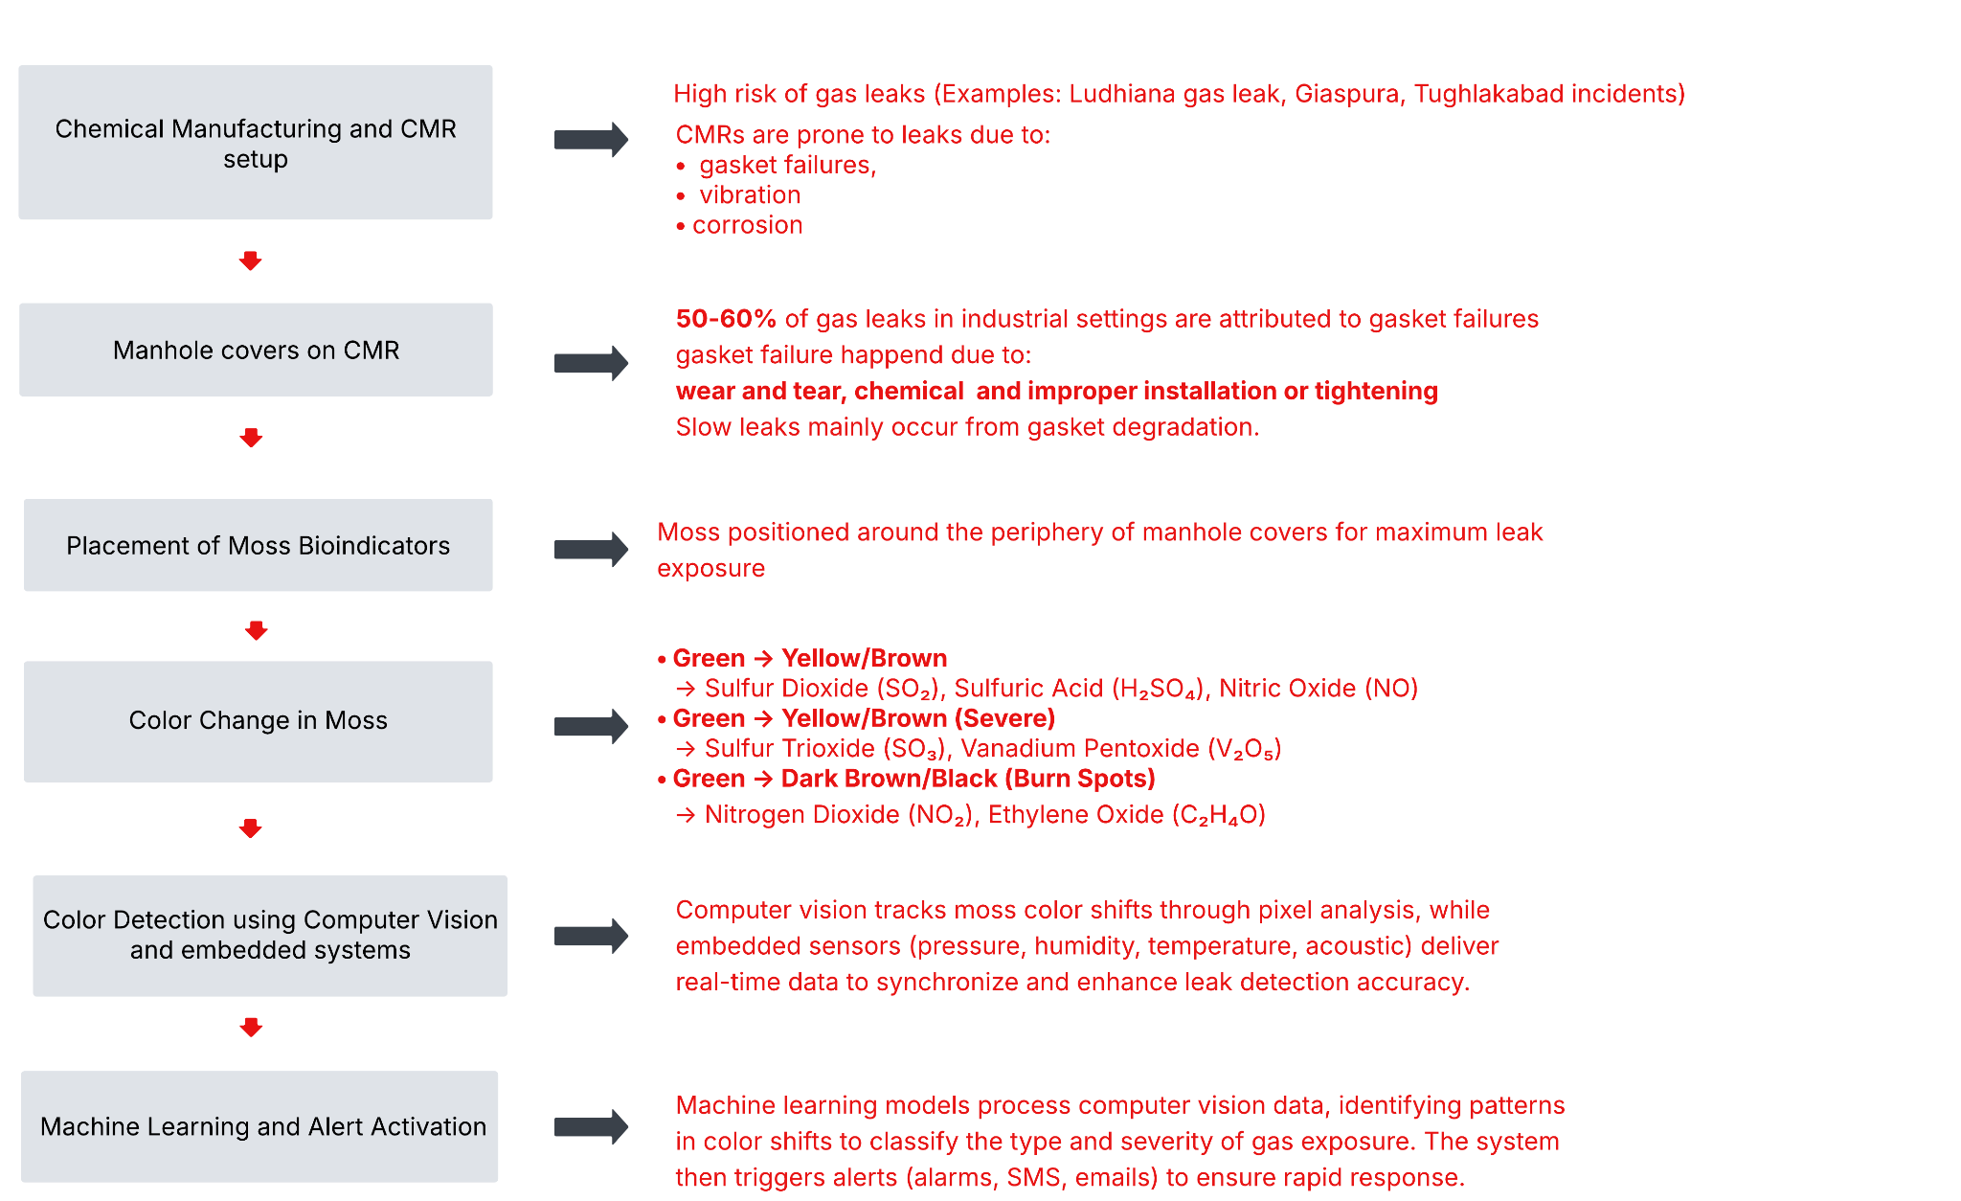
Methodology

Slide 14
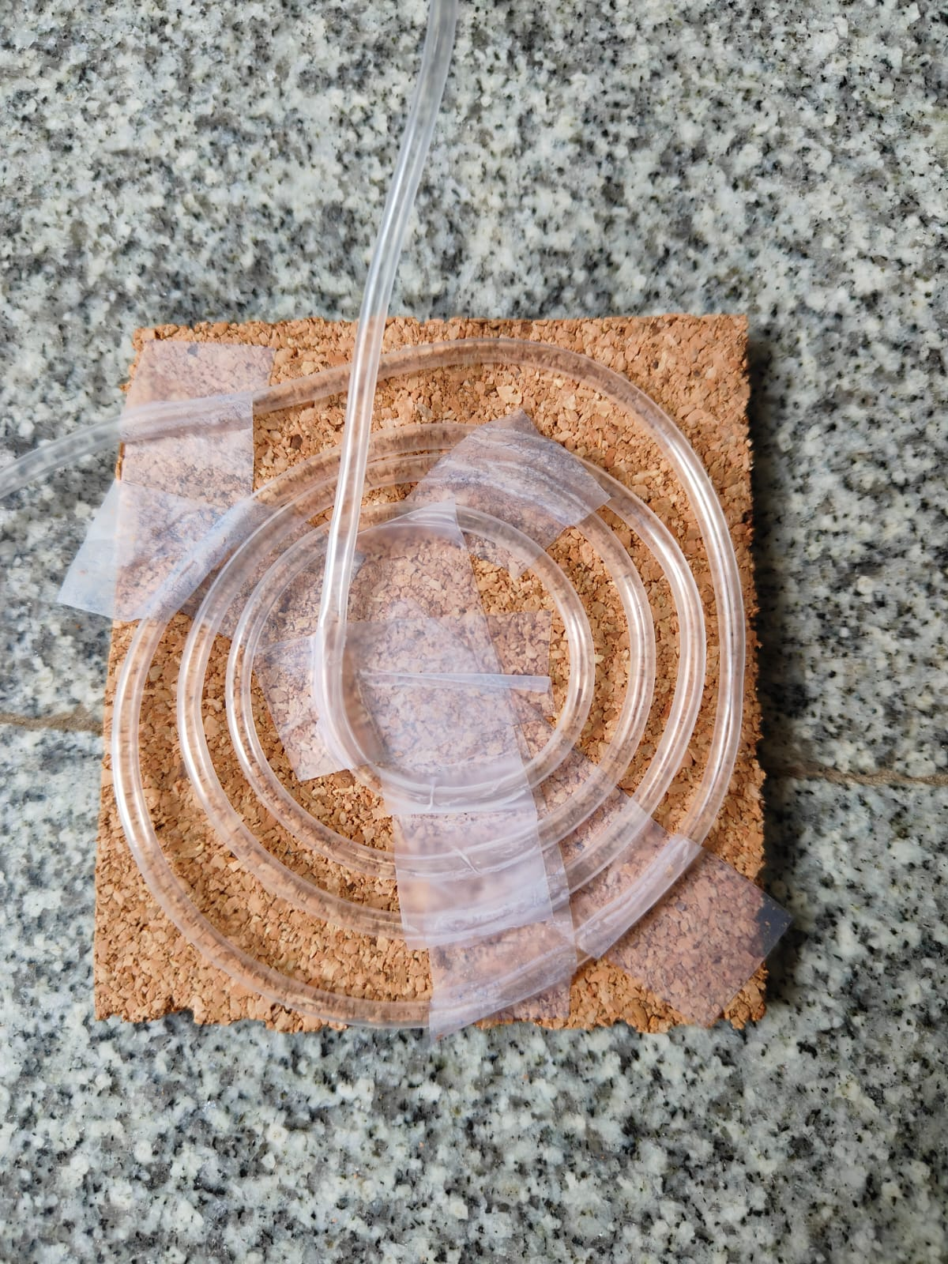
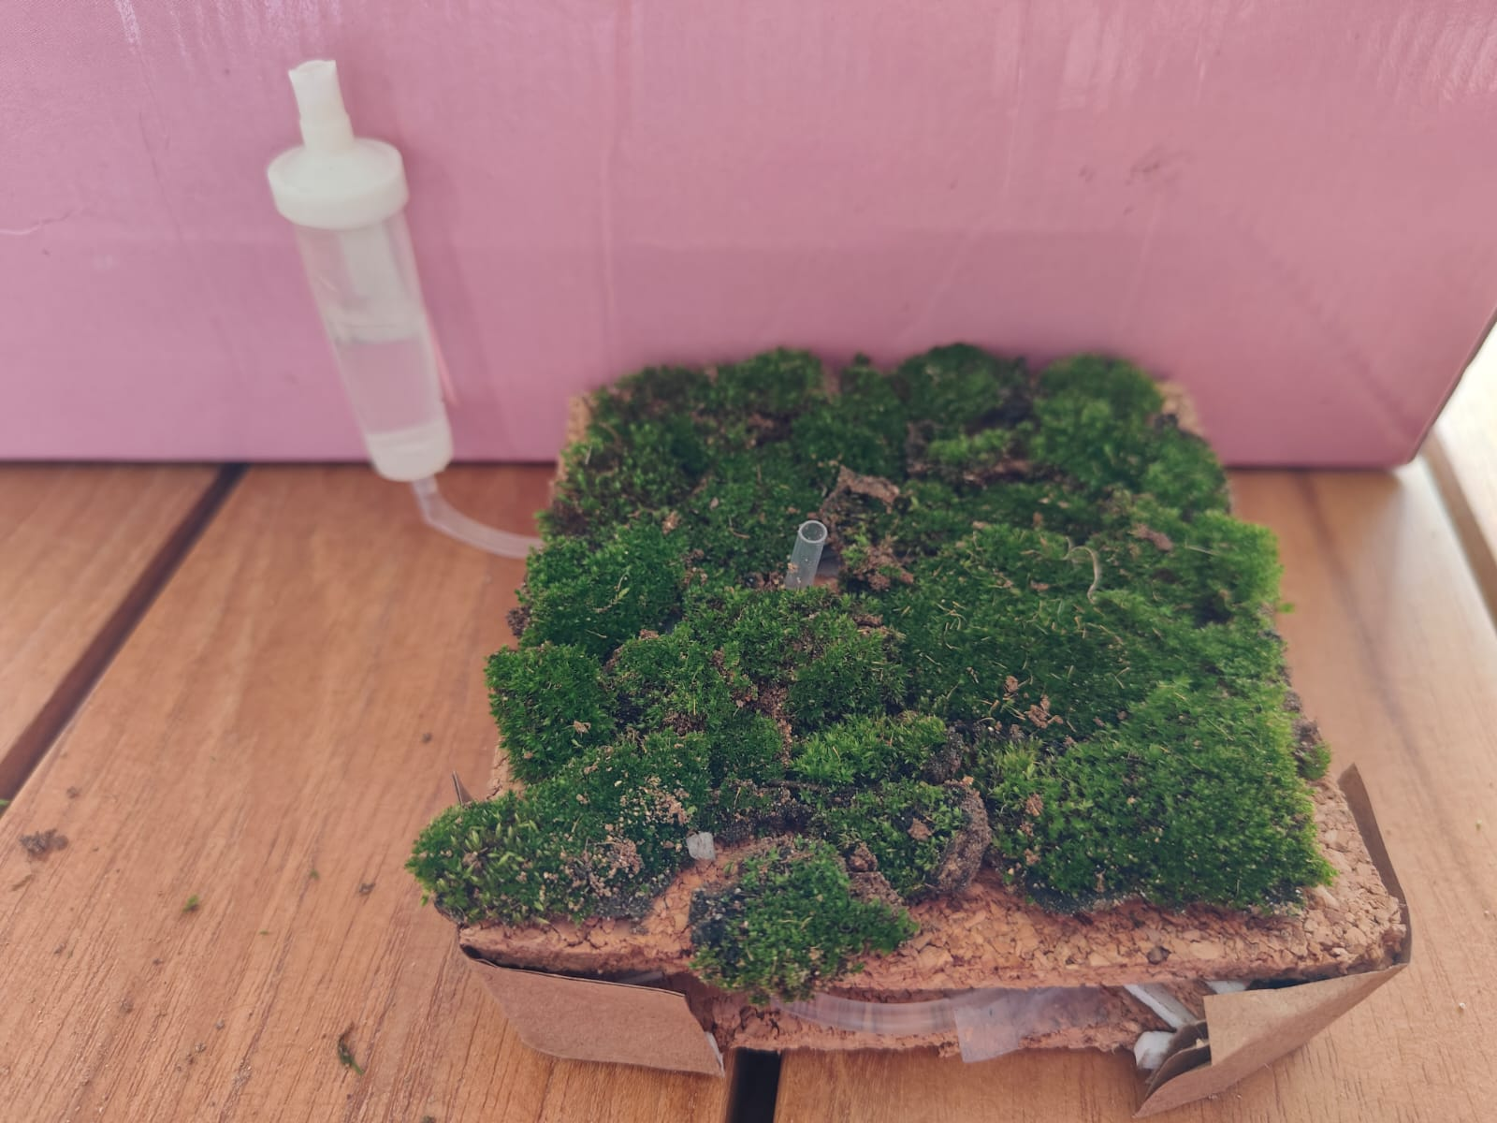
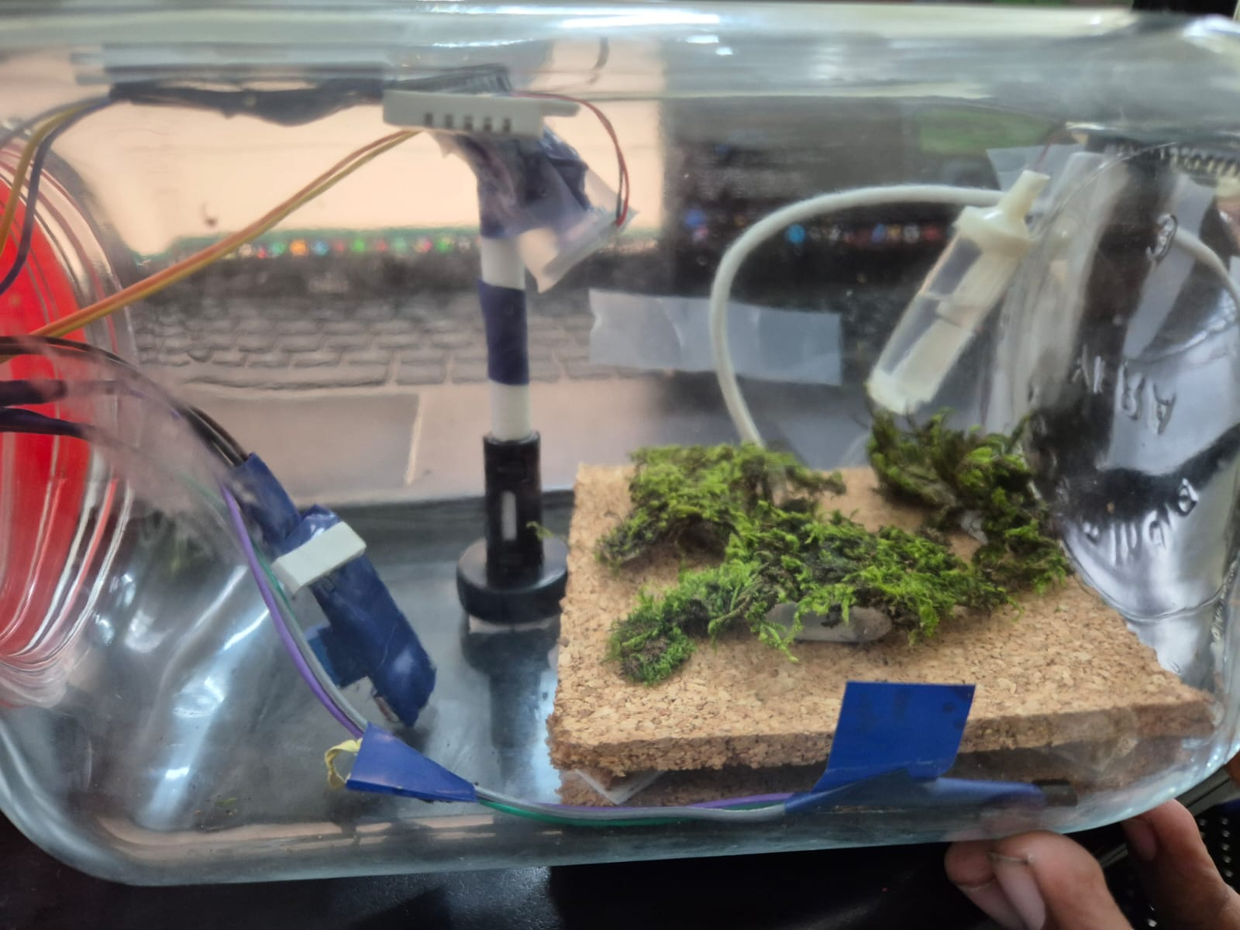
Methodology-Experimental Setup
Experimental Setup: Moss-Based Gas Leak Detection System
Glass Jar Reactor Simulation
A transparent glass jar simulates a gasket of a Chemical Mixing Reactor (CMR).
Moss is placed inside the jar on two layers of cork sheets.
A drip irrigation pipe runs between the cork layers, connected to a small external water tank, ensuring continuous hydration.
This setup supports long-term moss viability and controlled growth conditions.
Environmental Control with Humidifier
A miniature humidifier is mounted on a vertical pole inside the jar.
The humidifier is connected to a glass ampule containing water,
producing cool water vapor.
This regulates temperature and humidity, simulating industrial vapor conditions and enhancing moss health.

Slide 15
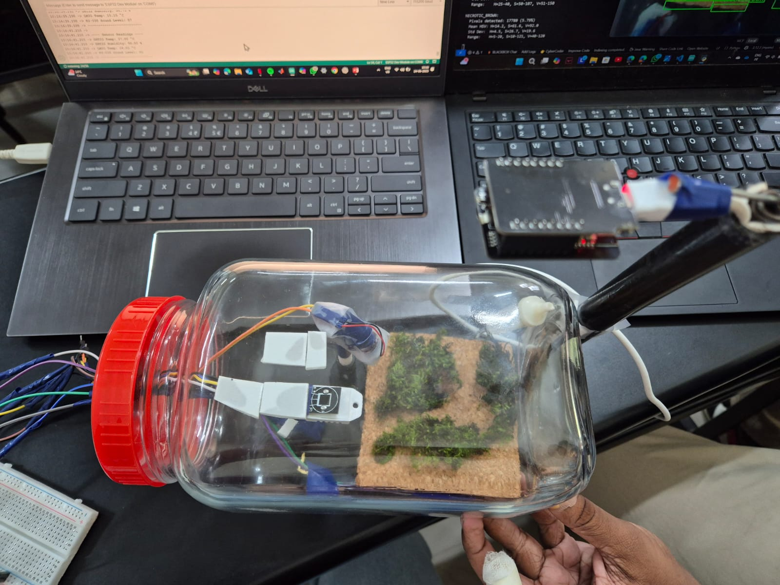
Methodology-Experimental Setup​
Sensor Placement & Monitoring
Three sensors are embedded inside the jar:
DHT22 – Measures ambient temperature and humidity.
LM35 – Measures surface temperature of the moss.
KY-038 – Detects hissing sounds from the humidifier, simulating gas leak acoustics.
Sensor wires exit via a central hole in the jar lid and connect to a breadboard + ESP32 microcontroller for data processing.
Image Monitoring with ESP32-CAM
Outside the glass jar, an ESP32-CAM module is mounted above the moss.
Captures periodic images for color analysis using HSV-based computer vision.
Enables real-time detection of chlorosis (yellowing) and necrosis (browning) due to gas exposure.

Slide 16

CONDUCTION OF THE EXPERIMENT
The experiment was conducted using 200 cm³ airtight plastic chambers, where moss samples were positioned on a raised platform fabricated from high-density foam board to ensure isolation from direct chemical contact. A 5 mL aliquot of each test chemical was absorbed onto a sterile cotton swab using non-reactive stainless-steel tweezers for safety handling.
The chemically treated cotton was then affixed adjacent to the moss samples on the foam board using medical-grade adhesive tape, ensuring proximity without direct contact. The inner rim of each chamber was sealed circumferentially using lab-grade sealing tape to prevent vapor leakage. The chamber was then closed with an airtight plastic lid and further reinforced using electrical insulation tape to avoid any unintended gas exchange with the external environment, thereby preserving the integrity of the chemical-moss interaction.

Slide 17





Tools and Techniques Used - SW
Software:
Python Programming language : Libraries such as OpenCV and NumPy were used to get the real time HSV(Hue ,Saturation, Value) digits through Computer Vision and store the HSV digits inside an array.
Arduino IDE: For programming and testing of ESP-32 Cam Wrover Module and the necessary sensors
Circuit.IO: To design and draw the digital circuit layout of the Microcontrollers and Sensors involved.
Blynk IOT: Integration of sensor output with Blynk Interface for development of Alarm System.

Slide 18
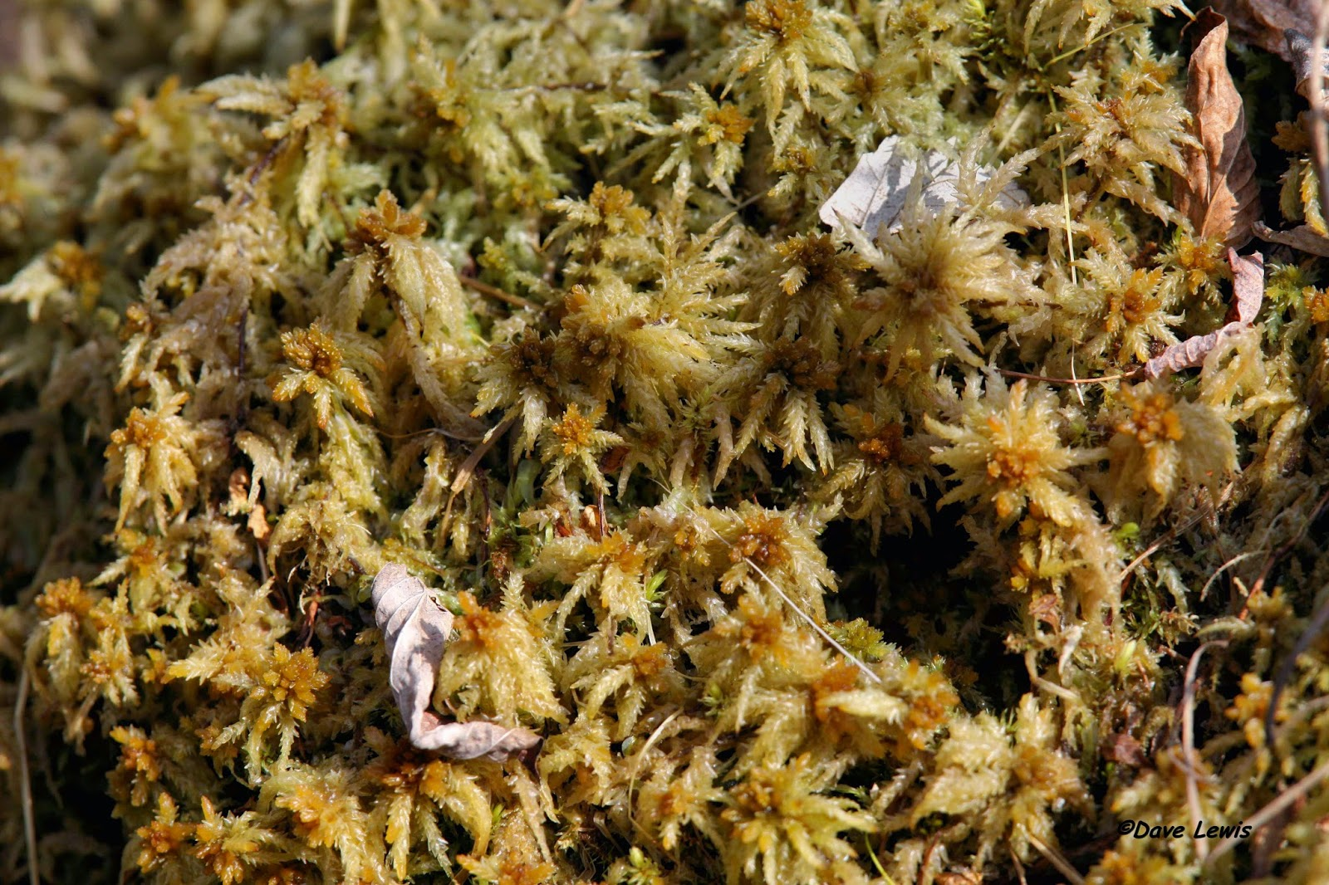
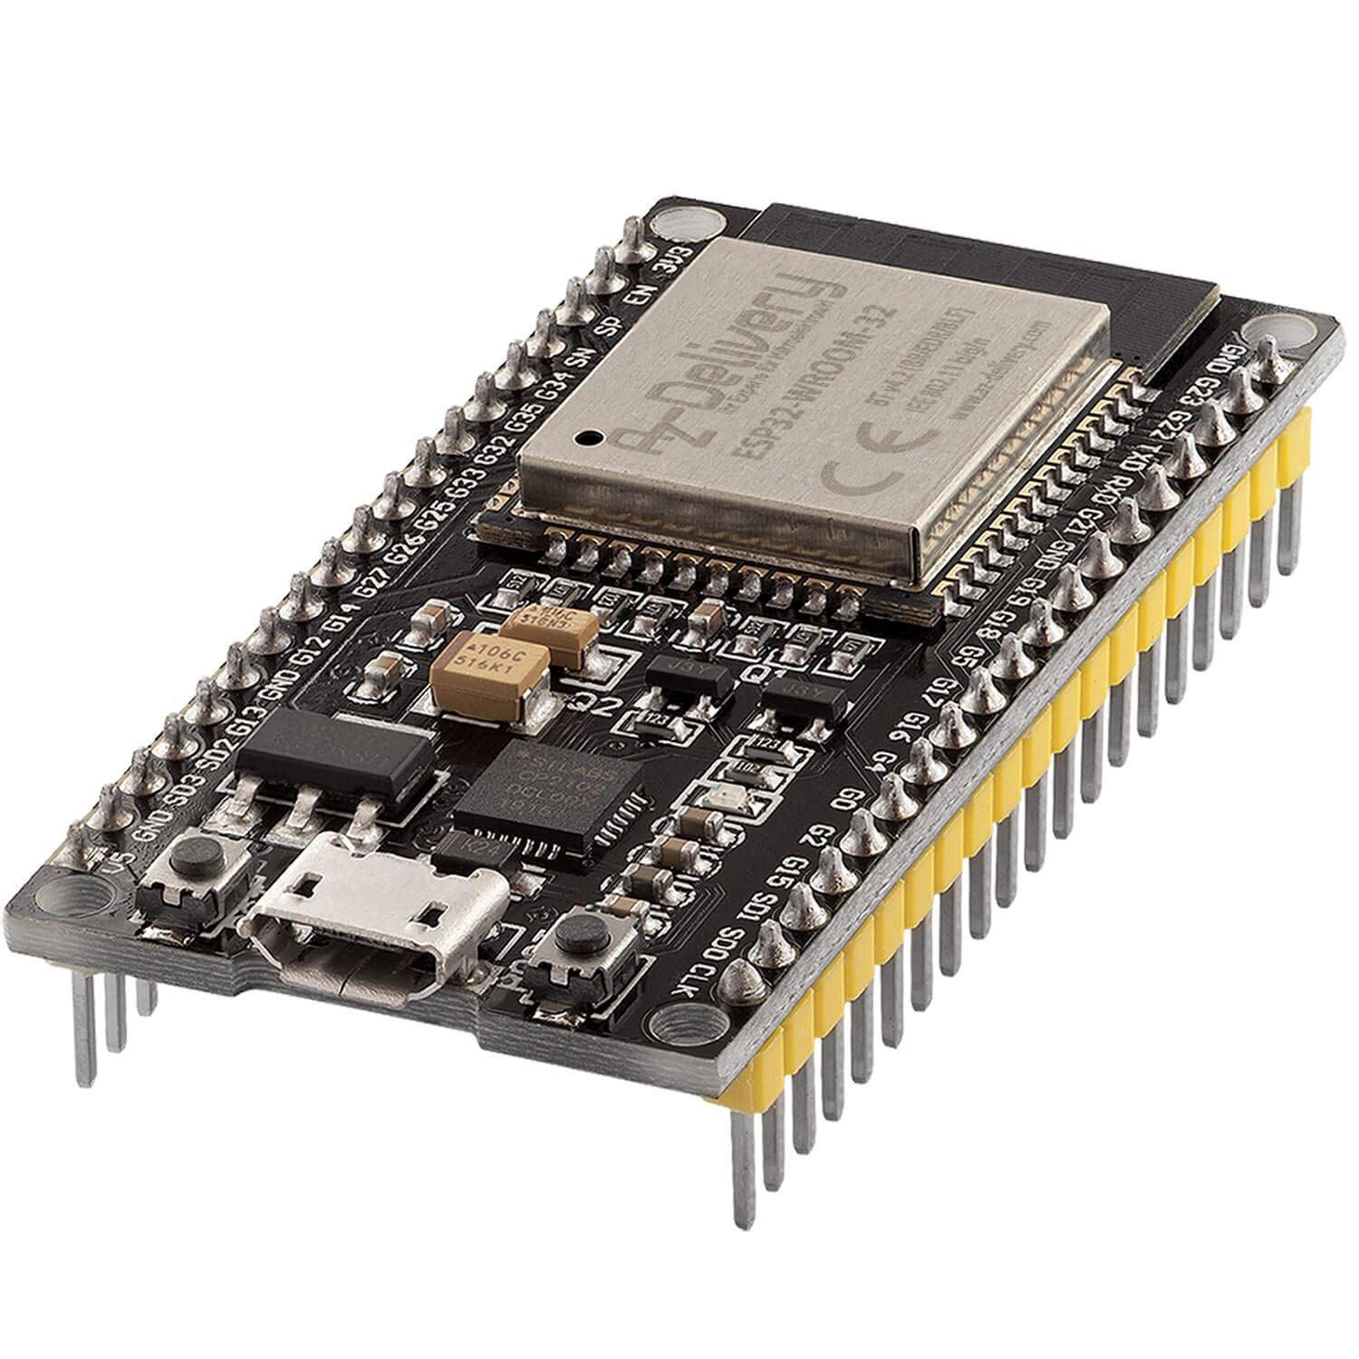
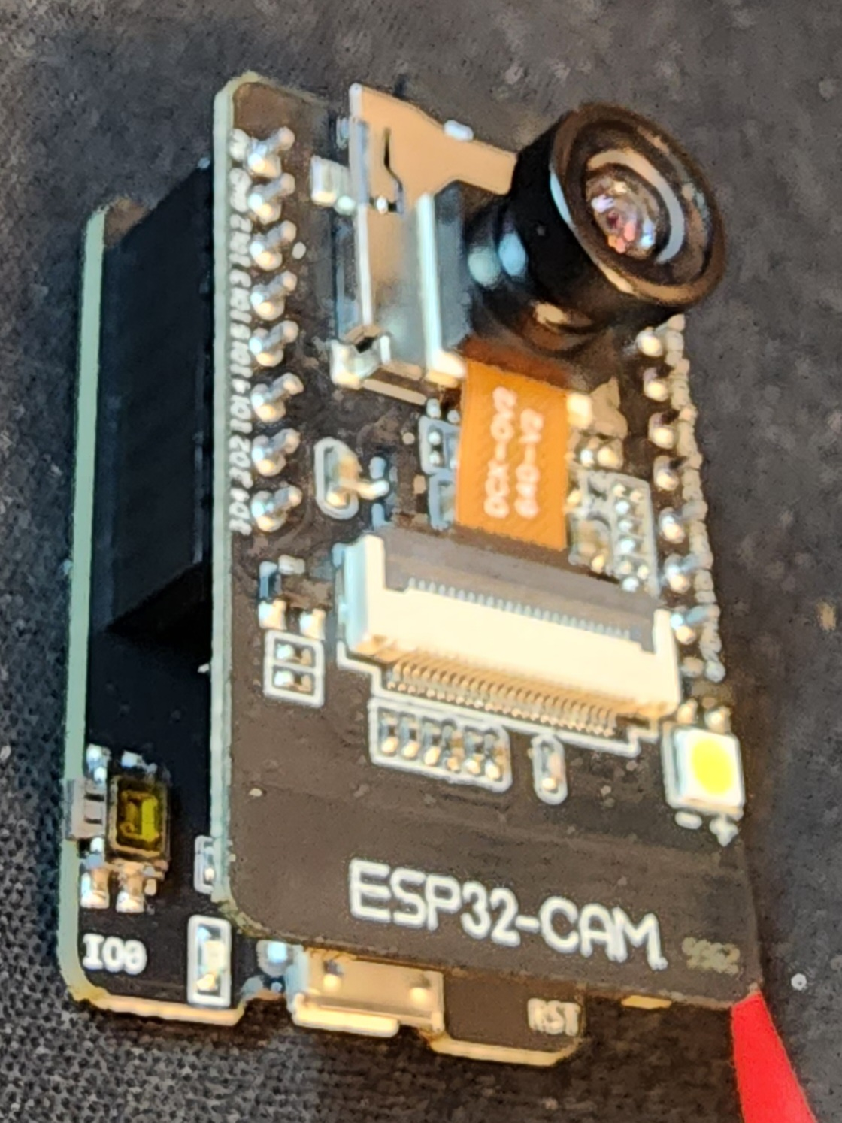
Tools and Techniques Used - HW
HARDWARE:
EQUIPMENT USED | OPERATING SPECIFICATIONS | REASONS
PEAT CUSHION MOSS | Peat moss can change colour due to chlorophyll degradation caused by exposure to certain gas and chemicals. | Suitable replacement for sphagnum moss and shows the desirable colour change.
ESP-32 DEV MODULE | Versatile Microcontroller board suitable IOT applications . Features dual-core 32-bit LX6 microprocessor, running at 160-240 MHz, with 520KB of SRAM and 448 KB of ROM | Core of the system integrating: Sensor readings Camera-based moss monitoring. WIFI for data logging.
ESP-32 WROVER CAM MODULE | Camera:OV2640 for capturing still images. Microcontroller : In-built ESP-32 chip to handle image processing and wireless communication. Connectivity: Built-in WIFI and Bluetooth for remote access | Used for monitoring the colour changes in the peat moss sample by successfully calibrating with Python OpenCV library for Computer Vision.

Slide 19




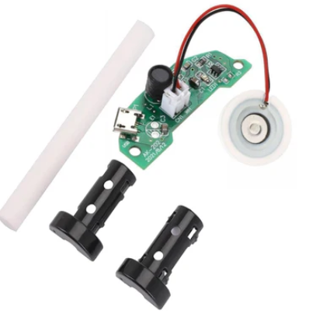
Tools and Techniques Used HW – Cont.
EQUIPMENT NAME | OPERATING VOLTAGE AND RANGE | REASON
KY-038(SOUND SENSOR) | Operating Voltage:3.3V Range:0-4095 ADC | Detects hissing or unusual leak sounds. Due to high sensitivity of the sensor pad it works well for early leak warnings.
LM-35(TEMPERATURE SENSOR) | Operating Voltage:3.3V Range:-55°C to +150°C | Used for monitoring the temperature of the moss.
DHT-22(TEMPERATURE SNF HUMIDITY SENSOR) | Operating Voltage:3.3V, Temp. Range:-40°C to +80°C, Humidity Range: 0% to 100% RH | Provides real-time temperature and humidity data to monitor environmental conditions influencing moss response.
BMP-180(PRESSURE SENSOR) | Operating Voltage:3.3V Range:30 to 110 kPa | Measures the variation in pressure buildup when there is a case of gas leak.
HUMIDIFIER | Operating Voltage: 5V, Oscillating frequency: 1.7Mhz | Used to produce vapours of different chemicals and water, simulating leak conditions while keeping the moss's condition healthy

Slide 20
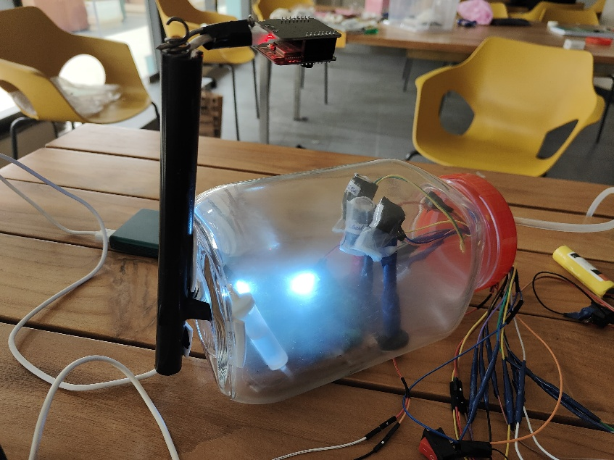
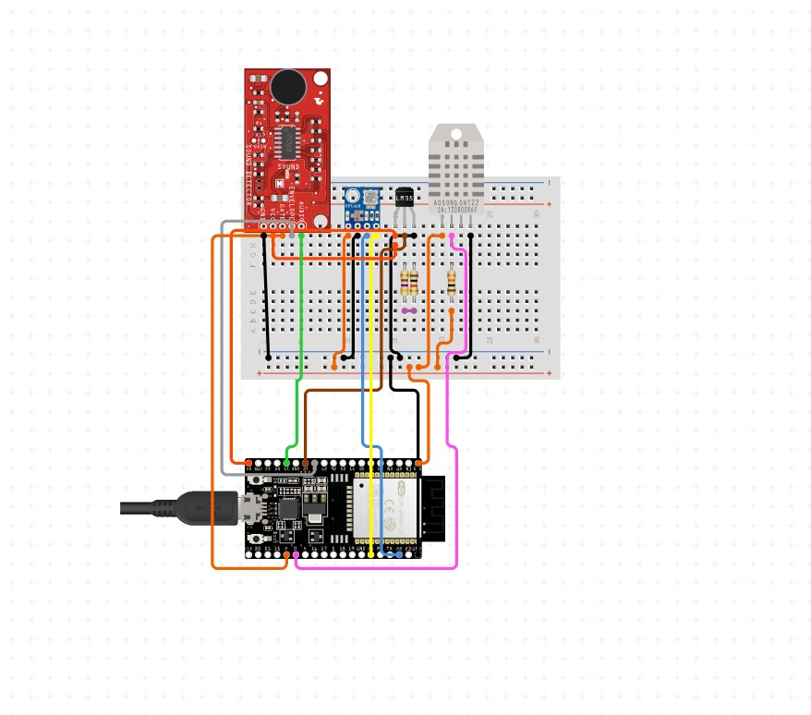
Design and Implementation
Setup Design: To implement gas leak situation , the setup consists of 2L volume glass jar where the sample peat cushion moss is placed along with white led’s,5V Humidifiers to release vapors of chemicals such as(Acetic Acid and Dil Sulphuric Acid) and water to maintain the moss temperature(10°-20°Celsius).Necessary sensors are placed near the moss sample to get readings. ESP-32 cam module is placed outside the jar to capture images with minimal to no glare.
Circuital Design:This circuit setup shows a microcontroller-based sensor monitoring system with the following components :
KY-038(Sound Sensor)
LM-35(Temperature Sensor)
DHT-22(Temperature and Humidity Sensor)
BMP-180(Pressure Sensor)

Slide 21
Analysis of Results
Peat cushion moss showed distinct colour changes when exposed to hazardous chemicals: Acetic Acid, Acetone, Dil. H₂SO₄, Ethyl Acetate, and Ammonium Hydroxide.
These visible symptoms—like chlorosis and necrosis—were accurately detected using the ESP32-CAM and analysed via OpenCV in the HSV colour space.
Significant HSV value shifts confirmed moss sensitivity and validated the use of computer vision for early gas leak detection.
The results support the project’s goal of creating a real-time, eco-friendly, and low-cost biosensor system for industrial safety, with potential for future chemical classification based on moss response patterns.

Slide 22
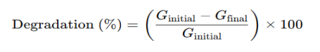
Analysis of Results​
Chemical-Specific Moss Response Moss showed distinct stress responses to different chemicals, validating its use as a biological indicator:
Ethyl Acetate(5 mL, 1:1 dilution with water): Caused mild chlorosis and delayed wilting. • Dilute Sulfuric Acid (H₂SO₄)(5 mL, 0.9% v/v): Led to rapid browning and necrosis—indicating high toxicity.
Ammonium Hydroxide(5 mL, ~0.1 M dilution): Triggered pale discoloration and upward leaf curling.
Acetone(5 mL, 1:1 dilution with water): Induced slow chlorosis with slight drying at leaf tips.
Glacial Acetic Acid(5 mL, ~100% or concentrated): Caused uneven yellowing and some patchy necrosis. These responses confirm that moss reacts differently to each chemical, paving the way for future chemical classification models based on symptom pattern recognition.
Degradation Formula:

Slide 23

Computer Vision: Color Detection Logic
Code Logic Overview
ESP32-CAM Connectivity:
Tries to connect to the ESP32-CAM stream using HTTP (requests.get()).
If unreachable, prints error and exits.
Fallback to Webcam:
Uses OpenCV's cv2.VideoCapture(0) to access local webcam.
Checks if the camera is available.
Color Thresholds (HSV):
'healthy_green': [40, 40, 40] to
[90, 255, 255]
'chlorotic_yellow': [25, 50, 50] to
[40, 255, 255]
'necrotic_brown': [5, 10, 10] to
[20, 180, 120]

Slide 24

Analysis of Results​
1. Detection Efficiency
The computer vision (CV) system enabled early detection of gas-induced stress in moss—identifying chlorosis (yellowing) in as little as 0.5 to 3.5 hours, compared to 24 to 72 hours required by the human eye. This ~95% reduction in detection time demonstrates the potential for real-time, automated gas leak monitoring, which is central to the project’s goals.
2. Chemical-Specific Moss Response
Moss showed distinct stress responses to different chemicals, validating its use as a biological indicator:
Ethyl Acetate(5 mL, 1:1 dilution with water): Caused mild chlorosis and delayed wilting.
Dilute Sulfuric Acid (H₂SO₄)(5 mL, 20% v/v): Led to rapid browning and necrosis—indicating high toxicity.
Ammonium Hydroxide(5 mL, ~0.1 M dilution): Triggered pale discoloration and upward leaf curling.
Acetone(5 mL, 1:1 dilution with water): Induced slow chlorosis with slight drying at leaf tips.
Glacial Acetic Acid(5 mL, ~100% or concentrated): Caused uneven yellowing and some patchy necrosis.
These responses confirm that moss reacts differently to each chemical, paving the way for future chemical classification models based on symptom pattern recognition.
Degradation Formula:

Slide 25
TABULAR INTERPRETATION​
​
Gas used in industry | Gas used for | Time (hrs) Naked eye | Time (hours) CV | HSV-before | HSV –after | Degradation % | Effect pattern
ACETIC ACID | ACETIC ACID | 1 | 0.5 | H: 40–80°, S: 50–255, V: 30–200 | H: 25–45°, S: 40–200, V: 60–220 | ~55–65% | Gradual stress; early chlorosis, later necrosis.
ACETONE | ACETONE | 48 | 2.5 | H: 45–75°, S: 60–255, V: 50–180 | H: 20–40°, S: 50–170, V: 50–150 | ~60–70% | Rapid damage; high necrosis → fast phytotoxicity.
ETHYLENE OXIDE (C₂H₄O) | ETHYL ACETATE | 72 | 3.5 | H: 45–80°, S: 50–255, V: 30–190 | H: 20–45°, S: 30–150, V: 30–120 | ~65–75% | Slow, steady degradation; mild necrosis.
CONC. SUPHURIC ACID | DIL. SUPHURIC ACID | 60 | 3 | H: 45–75°, S: 70–255, V: 60–180 | H: 30–50°, S: 40–180, V: 40–140 | ~45–55% | Chlorosis → necrosis; progressive breakdown.
AMMONIA GAS (NH₃) | AMMONIUM HYDROXIDE | 24 | 2 | H: 45–80°, S: 60–255, V: 45–180 | H: 15–35°, S: 30–150, V: 30–110 | ~70–80% | Direct necrosis; little chlorosis due to fast cell death.

Slide 26
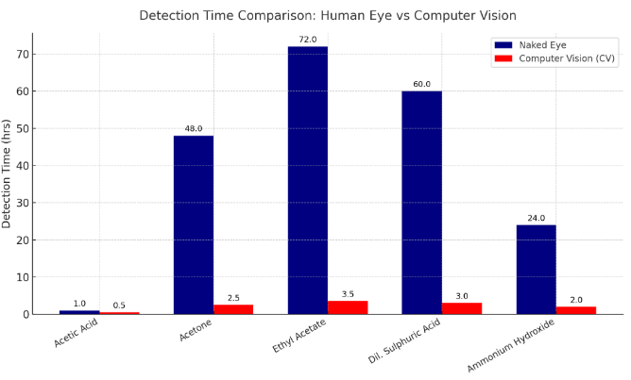
Analysis of Results​

Slide 27
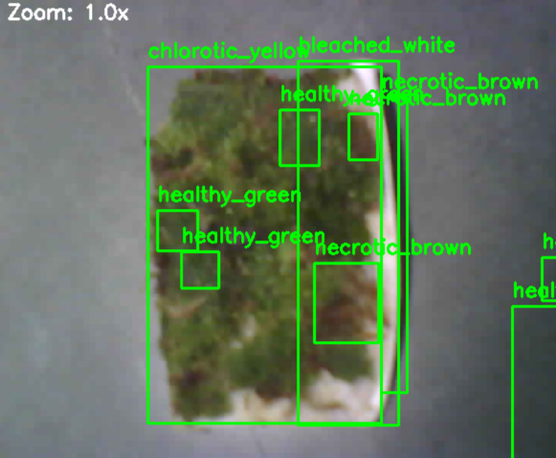
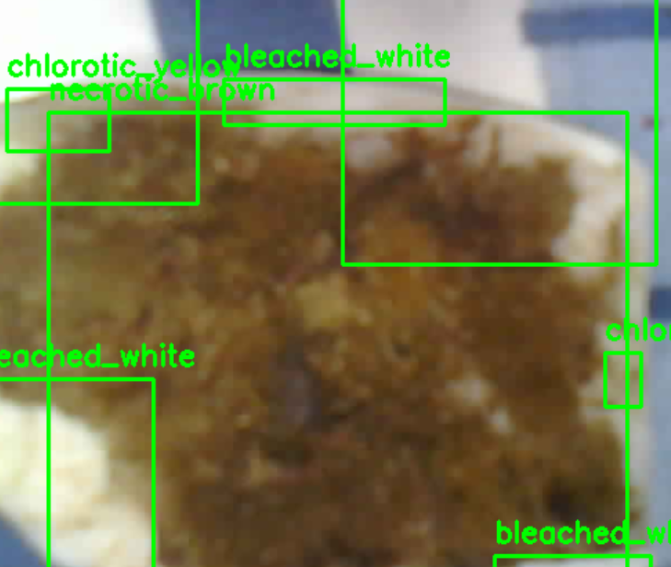
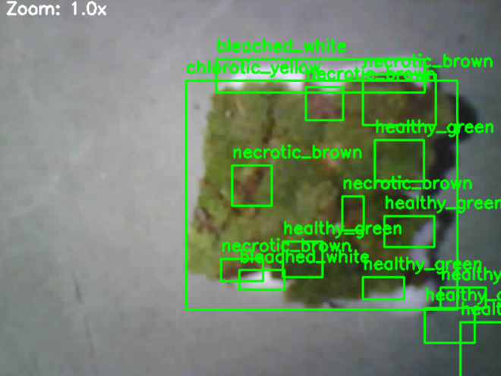
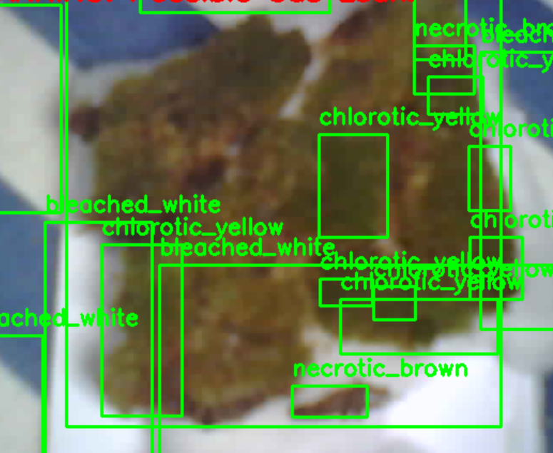
Analysis of Results​​​
MOSS SAMPLES UNDER OPENCV
a)Moss sample when exposed to Acetic Acid
b) Moss sample when exposed to Dilute Sulfuric Acid (H₂SO₄)
OpenCV captures frames from the ESP32-CAM and converts each image from BGR to HSV format. The HSV model separates color into three components:
Hue (H): Type of color (e.g., green ~60°, yellow ~30°, brown ~10–20° with low saturation)
Saturation (S): Intensity of the color
Value (V): Brightness of the color

Slide 28
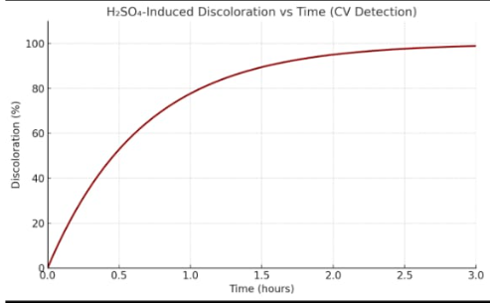
Analysis of Results​​​​
Fig illustrates the progression of discoloration (%) in moss samples exposed to sulfuric acid (H₂SO₄) over a 3-hour period, as quantified by computer vision algorithms. The horizontal axis represents time in hours, while the vertical axis indicates the percentage of discoloration detected relative to the baseline green coloration.
An initial rapid increase in discoloration is observed within the first 1 hour, with values exceeding 80% of total measurable pigment loss. The curve then exhibits a decelerating trend, approaching an asymptotic maximum near 100% discoloration. This saturation behavior indicates the completion of pigment degradation and tissue damage.

Slide 29
Challenges Faced
IMPLEMENTATION OF HUMIDIFIRES:
During system design, low-voltage (5V) ultrasonic humidifiers were incorporated to simulate high-humidity environments for stress testing the moss. However, challenges arose due to voltage instability when multiple peripherals were powered from a single source and also the mist buildup which can hinder the HSV readings
STRATEGY
A dedicated power regulation module was introduced to stabilize current delivery to each humidifier.
An exhaust valve at the lid of the jar to release the buildup mist caused by humidifiers.
LIGHT GLARE
Computer vision-based color detection was affected by specular glare and light reflections from the transparent chamber walls effecting the corresponding HSV values.
STRATEGY
The camera angle was adjusted to minimize direct reflection, and adaptive histogram equalization was applied in the CV algorithm to correct lighting inconsistencies.

Slide 30
Final Outcome
The final prototype delivers a robust, real-time toxic gas detection system that integrates biological sensing, computer vision (CV), and IoT-based monitoring. By leveraging the bioindicator behavior of peat cushion moss, the system successfully detects early colorimetric stress responses caused by chemical exposure, including acetic acid, sulfuric acid, acetone, ethyl acetate, and ammonium hydroxide.
The solution comprises the following components:
ESP32-CAM module capturing high-resolution moss imagery.
OpenCV-based color analysis in the HSV space to classify stress into Healthy (Green), Chlorotic (Yellow), and Necrotic (Brown) states.
Environmental sensors (DHT22 for humidity, LM35 for temperature, KY-038 for sound, BMP-180 for pressure) to provide contextual data.
Blynk IoT dashboard for real-time visualization, remote alerts, and automated alarm triggering when critical stress thresholds are reached.
The system demonstrates:
Up to 95% reduction in gas leak detection time compared to traditional electrochemical sensors,
High sensitivity to low concentrations of gas based on moss response,
Real-time data availability via mobile and cloud interfaces,
Low power consumption, eco-friendly implementation, and scalability for industrial settings.

Slide 31
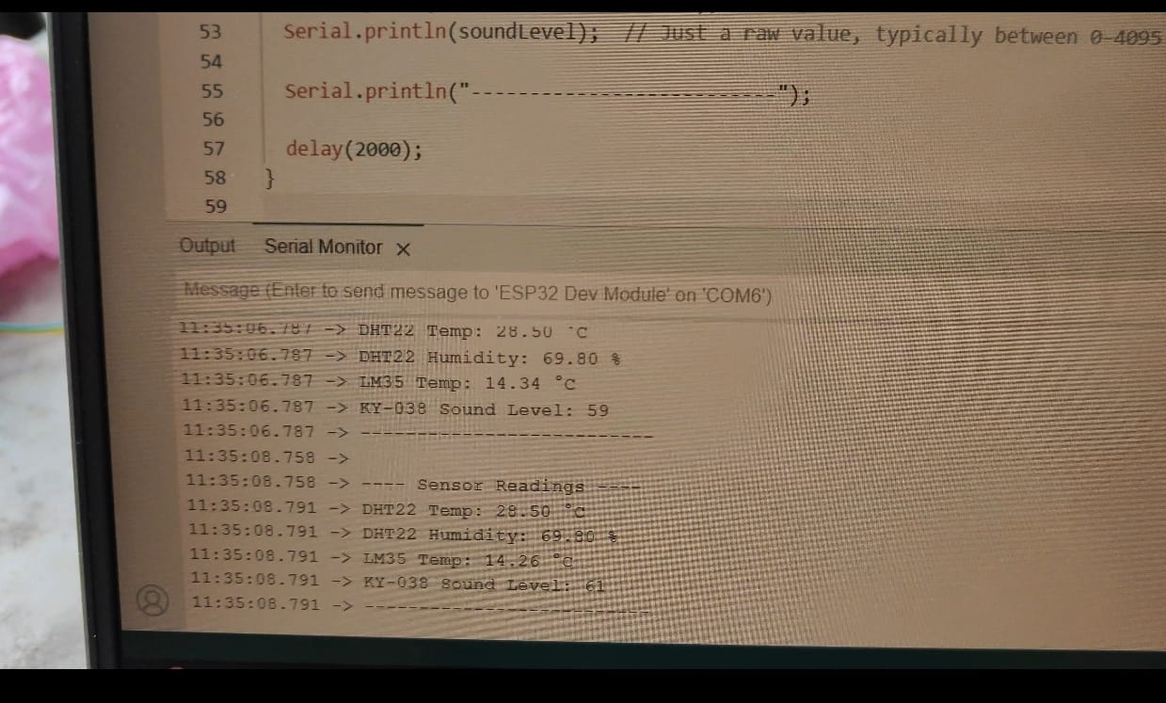
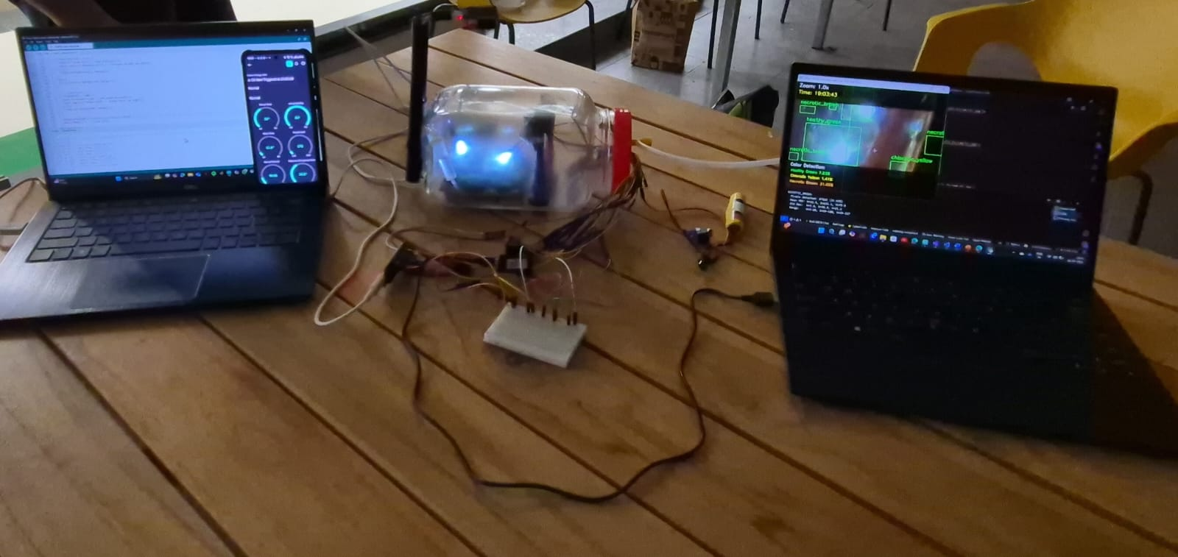

Final Outcome​

Slide 32
Our Study vs Existing Research
Previous studies on moss exposed to sulfur dioxide (SO₂) report rapid yellowing due to acidinduced chlorosis. While our project uses liquid sulfuric acid (H₂SO₄) instead of SO₂, both cause similar acid stress—making SO₂ a valid biological proxy. As shown by Yates and Pearson (1980) in The Effects of Acid Rain on Mosses, acidic conditions disrupt cells, leach nutrients, and degrade pigments, leading to visible damage consistent with our observations.
• Similarly, exposure of moss to ammonium hydroxide (NH₄OH) in our study reflects effects reported for airborne ammonia (NH₃). Since NH₄OH dissociates into NH₄⁺ and NH₃, it mimics the physiological impact of gaseous ammonia. As shown in “Effects of Atmospheric Ammonia on Vegetation – A Review” by Fangmeier et al. (1994), such exposure can cause ammoniacal stress, leading to chlorosis, necrosis, and pigment degradation. The symptoms observed in our controlled leak scenario are consistent with those seen in NH₃ pollution studies.
• Notably, for chemicals like acetic acid, acetone, and ethyl acetate, time-based quantitative data on moss color change is absent in existing literature—highlighting a gap our study fills by providing short-term, measurable visual outcomes.

Slide 33
Our Study vs Existing Research
Previous studies on moss exposed to sulfur dioxide (SO₂) report rapid yellowing due to acid-induced chlorosis. While our project uses liquid sulfuric acid (H₂SO₄) instead of SO₂, both cause similar acid stress—making SO₂ a valid biological proxy. As shown by Yates and Pearson (1980) in The Effects of Acid Rain on Mosses, acidic conditions disrupt cells, leach nutrients, and degrade pigments, leading to visible damage consistent with our observations.
Similarly, exposure of moss to ammonium hydroxide (NH₄OH) in our study reflects effects reported for airborne ammonia (NH₃). Since NH₄OH dissociates into NH₄⁺ and NH₃, it mimics the physiological impact of gaseous ammonia. As shown in “Effects of Atmospheric Ammonia on Vegetation – A Review” by Fangmeier et al. (1994), such exposure can cause ammoniacal stress, leading to chlorosis, necrosis, and pigment degradation. The symptoms observed in our controlled leak scenario are consistent with those seen in NH₃ pollution studies.
Notably, for chemicals like acetic acid, acetone, and ethyl acetate, time-based quantitative data on moss color change is absent in existing literature—highlighting a gap our study fills by providing short-term, measurable visual outcomes.

Slide 34
INTERPRETATION AND INFERENCE
The DHT22 shows ambient indoor room conditions ranging from 27◦C to 29◦C.In the cases of gas leaks in chemical mixing reactors(CMRs),temperatures go up as high as 300◦C.
Moss Surface Temperature measured by LM35 ranges from 14◦C to 16◦C which is the ideal condition for moss to grow showing healthy green state. Gas leaks causes moss surface temperature to rise up to almost 20◦ showing almost 5◦C difference due to chlorotic degradation(yellowing) process. Constant drip irrigation through corkwood maintains the moss temperature which in turn reverses the degradation turning moss back to healthy green
KY-038 shows variation of sound intensity ranging from 58-62dBs at the normal environment conditions. The slow hissing sound from the gasket gives the sound intensity ranges from 68-70dBs.

Slide 35
Deliverables and Outcomes
List of key deliverables completed so far
Working Prototype: Transparent moss-based setup simulating a CMR gasket, integrating ESP32, sensors, humidifier, and drip irrigation for long-term moss viability.
Computer Vision System: HSV-based color detection via OpenCV on ESP32-CAM, identifying healthy, chlorotic, and necrotic moss in real time.
Multisensor Network: DHT22, LM35, and KY-038 sensors track humidity, temperature, and sound for environmental monitoring.
Drip Irrigation: Cork sheet and embedded pipe system ensures consistent hydration with minimal maintenance.
Experimental Dataset: Controlled exposure results for five chemicals, capturing moss color change timelines, HSV shifts, and sensor readings.
Documentation: IEEE report, slides, image analysis, and interpretation charts compiled for Phase II review.

Slide 36
Deliverables and Outcomes​
2. Quality & Scope
Deliverables meet goals of real-time, low-cost, eco-friendly gas leak detection. The prototype is robust, modular, and scalable, with reliable performance under controlled testing. Software architecture allows future machine learning integratio
3. Contribution to Project Goals
The system achieves key objectives of biological gas detection, enabling:
Early leak detection through visible moss response
Integrated digital monitoring for remote alerts
Safe and repeatable chemical exposure simulation
Scalable design for industrial applications
It lays the groundwork for Phase III: gas classification and cloud-connected alert systems.
Visual documentation: Include images or screenshots of completed deliverables, prototypes, or models.

Slide 37
Conclusion
This project demonstrates a novel, eco-friendly, and cost-effective approach to hazardous gas detection by integrating biological indicators (moss) with artificial intelligence. The successful use of computer vision to detect subtle colour changes highlights its potential for continuous, real-time environmental monitoring in industrial and urban settings, offering enhanced safety, early intervention, and scalable deployment.
Achieved faster gas detection using computer vision (CV), reducing detection time by up to 95% compared to the naked eye.
CV detected early chlorosis within 0.5–3.5 hours, vs 24–72 hours by human observation.
Progress aligns with project goals of real-time gas leak detection using moss color change
Gained key insights into chemical-specific responses and moss sensitivity.
Sets a strong foundation for Phase-III automation and real-time alert systems.
Grateful for the support from mentors and collaborative team efforts.

Slide 38
Summary & Alignment with Objectives
Biological Integration: Moss successfully embedded on cork substrate and exposed to controlled H₂SO₄, vapors, initiating pigment stress responses aligned with the goal of passive gas detection.
Vision System Initiated: Successfully Calibrated and tested for colorimetric monitoring of moss within the reaction chamber for maximum visibility and minimal glare.
Environmental Monitoring Active: DHT22, BMP280, and KY-038 sensors integrated and logging real-time environmental data to correlate with moss responses.
System Foundations Laid: Core components—biosensor, sensors, chamber, and hydration—now functional, forming a robust base for intelligent alerting and ML-based detection.

Slide 39
Acknowledgments
We would like to express our heartfelt gratitude to our project mentors(Ms. Manasa M. ,Prof Keshavmurthy YC ) for their invaluable guidance, encouragement, and continuous support throughout the development of this research. Their insights, technical expertise, and constructive feedback played a crucial role in shaping the direction and outcome of our work.
We are also deeply thankful to the Biotechnology Laboratory Supervisor for providing us with a safe and well-equipped environment to conduct chemical exposure experiments. The supervision and safety protocols ensured that all experimental procedures were carried out responsibly and efficiently, enabling us to obtain reliable and accurate results without compromising on safety.
This project would not have been possible without the collaborative efforts and mentorship extended to us, and we remain truly appreciative of the learning experience and support provided throughout this journey.

Slide 40


